Slide 1
NextHikes IT Solutions
Exploratory Data Analysis (EDA) for Real Estate Pricing: Unveiling the Dynamics of House Valuation in a Dynamic Market
by Harsimran Kaur

Slide 2
Project Overview
This research focuses on studying house price data to better understand the elements that determine property values. Exploratory Data Analysis (EDA) was used to investigate the patterns, distributions, and correlations between major home characteristics. The dataset was cleaned, missing values were addressed, and significant numerical and categorical factors were examined. A variety of visualizations were utilized to discover patterns in property size, quality, amenities, and price behavior. The findings of this study contribute to a better understanding of the primary drivers of house prices and aid in real estate decision making.

Slide 3
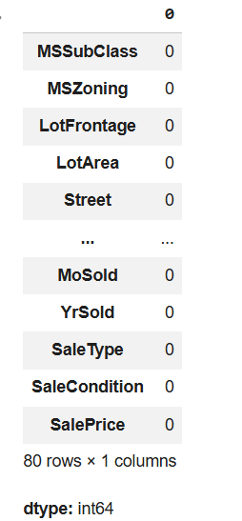
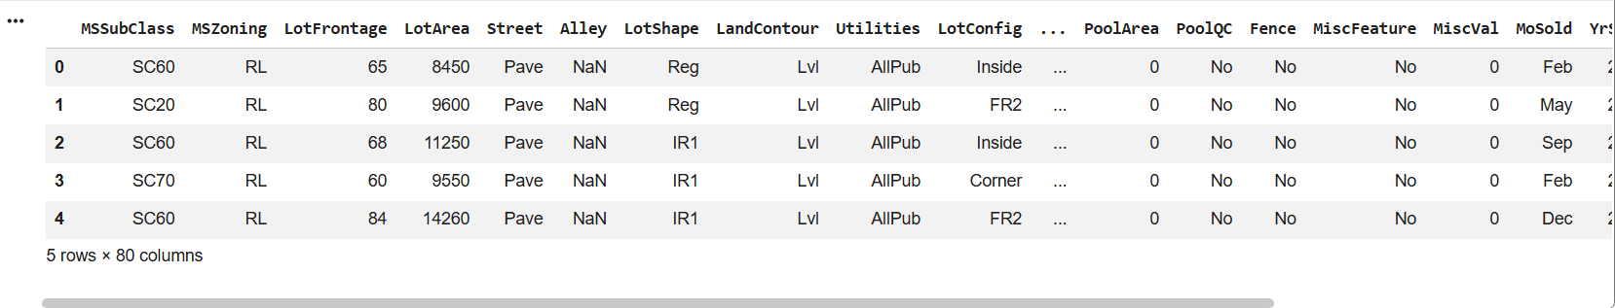
Step 1: DATA PREPROCESSING
1.Missing values and duplicate records were handled
2. Unnecessary columns were removed
3. Dataset was cleaned and prepared for analysis

Slide 4
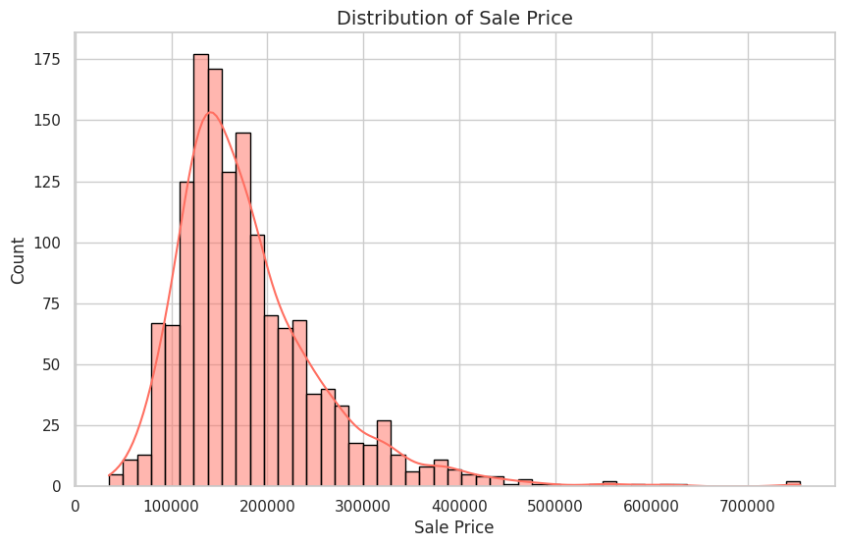
Step 2: Univariate Analysis (Numerical)
1. Sale prices are right-skewed
2. Most houses fall in the low to mid-price range
3. Few high-priced properties exist

Slide 5
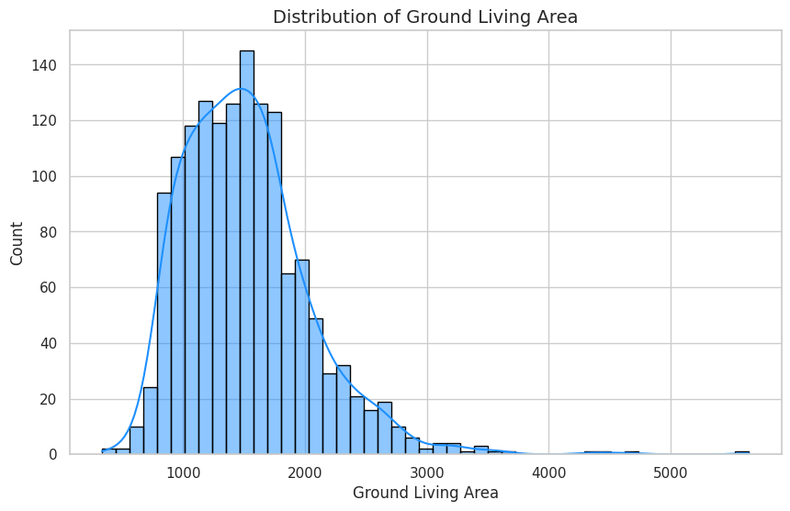
Step 2.1: Univariate Analysis – Property Size
1. Most houses have moderate living area
2. Distribution is right-skewed
3. Very large houses are limited in number

Slide 6
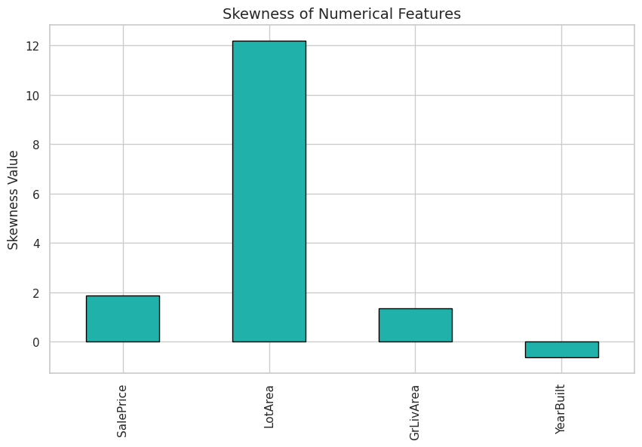
Step 3: Skewness Analysis – Key Observation
1. Sale Price, Lot Area, and GrLivArea are right-skewed
2. Most houses fall in lower to mid-value ranges
3 Few high-value properties create long right tails

Slide 7
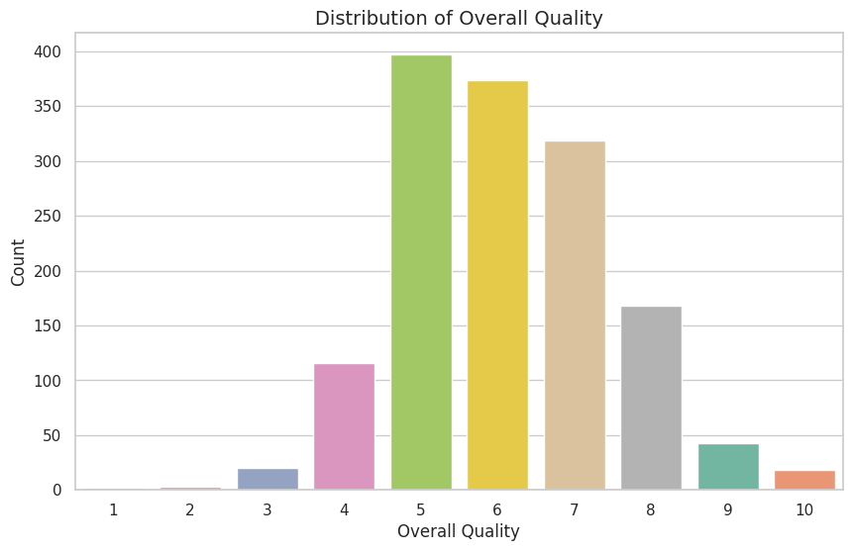
Step 4: Univariate Analysis – Categorical Features
1. Most houses fall in average to good quality range
2. Very high-quality houses are limited in number
3. Quality varies significantly across properties

Slide 8
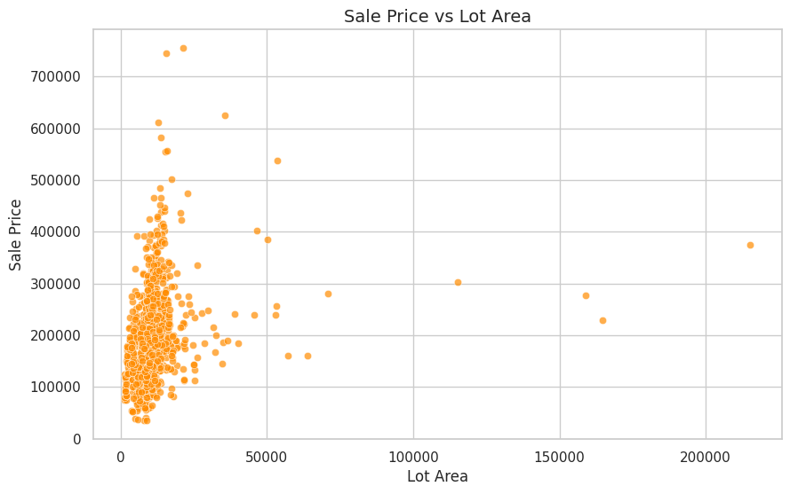
Step 5: Bivariate Analysis – Sale Price vs Lot Area
1. Larger lot areas generally tend to have higher prices
2. Relationship is weak to moderate
3. Lot size alone does not determine price

Slide 9
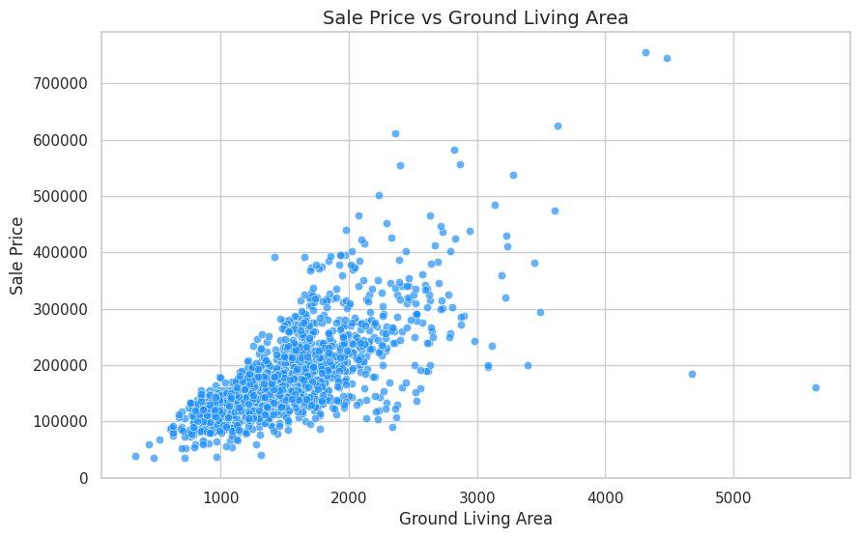
Step 6: Bivariate Analysis – Sale Price vs Living Area
Compared to lot area, living area shows a much stronger influence on house prices.

Slide 10
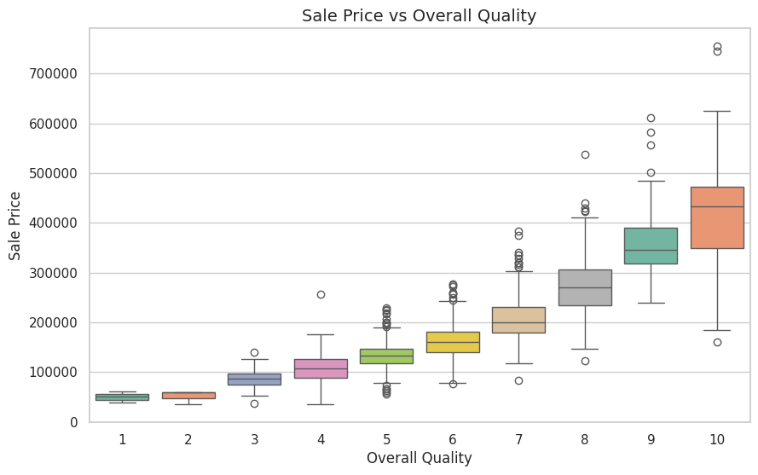
Step 7: Bivariate Analysis – Sale Price vs Overall Quality
1. Sale price increases with improvement in overall quality
2. Higher quality houses have higher median prices
3. Quality plays a key role in house pricing

Slide 11
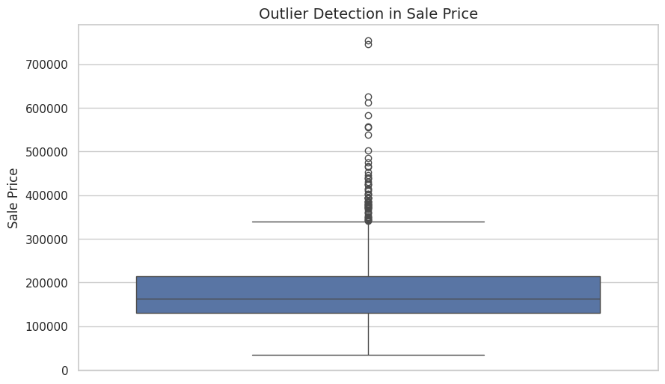
Step 8: Outlier Observation
1. Some high-priced properties appear as outliers
2. These represent genuine luxury houses
3. Outliers were retained to reflect real market behavior

Slide 12
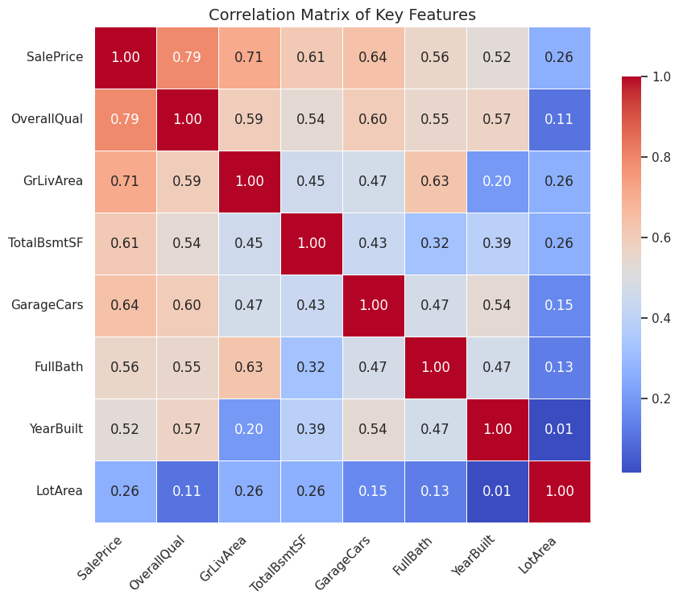
Step 9: Correlation Analysis
1. Sale Price has strong correlation with OverallQual and GrLivArea
2. GarageCars and TotalBsmtSF show moderate positive correlation
3. LotArea has weaker influence on price

Slide 13
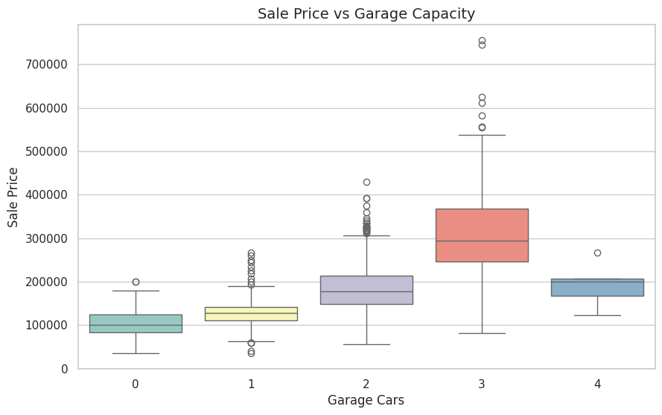
Step 10: Amenities Analysis
1. Houses with more amenities tend to have higher prices
2. Garage capacity shows a positive impact on sale price
3. Amenities add value but are secondary to quality and size

Slide 14
Challenges, Learnings & Summary
Extreme home prices, unreliable data, and missing values were among the difficulties encountered during the analysis. These problems were resolved by meticulously cleaning the data and employing visual analysis to identify trends without eliminating reliable observations. The overall analysis revealed that living area and overall quality have the most effects on home pricing, with amenities adding extra but secondary value. This study serves as an example of how exploratory data analysis can successfully yield insightful information and facilitate improved decision-making.

Slide 15
Thank you

